Slide 1




CS646: OWL Tutorial (session 1)
Presented by the CO-ODE and HyOntUse projects
Funded by

Slide 2
CS646: Overview
Session 1: Interface basics
Session 2: Defining a vegetarian pizza

Slide 3
CS646: This session
Review: OWL Basics
Intro: Protégé-OWL
Interface: Creating Classes
Concept: Disjointness
Interface: Creating Properties
Concept: Describing Classes
Interface: Creating Restrictions

Slide 4
Review of OWL (30 secs)
OWL…
is a W3C standard – Web Ontology Language
comes in 3 flavours (lite, DL and full)
  we are using OWL DL (Description Logic)
  DL = decidable fragment of First Order Logic (FOL)
is generally found in XML/RDF syntax
is therefore not much fun to write by hand
So, we have tools to help us

Slide 5
OWL Constructs
Person
lives_in
Country
Elvis
Belgium
Holger
lives_in
Paraguay
= class (concept)
Kylie
Latvia
S.Claus
China
= property (relationship)
Hai
lives_in
= individual (instance)
has_pet
has_pet
Flipper
Animal
Rudolph

Slide 6
Get Protégé-OWL
Logon to Windows
Go to: http://www.cs.man.ac.uk/~drummond/cs646/
Open protege3beta.zip
Extract to C:\
Open C:\Protégé_3.0_beta

Slide 7
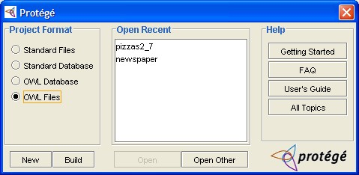
Starting Protégé-OWL
Run Protégé.exe
Select “OWL Files”
Select “New”

Slide 8
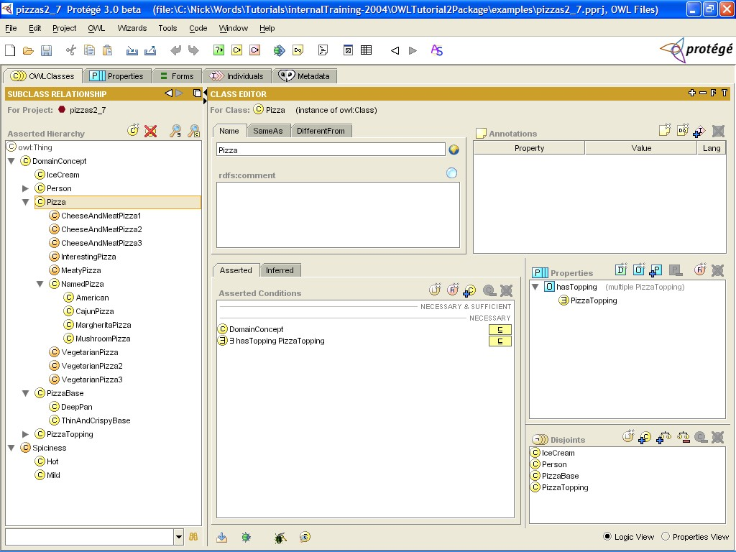
Protégé OWL plugin
Protégé tabs

Slide 9
Protégé OWL plugin: Tabs
Used in this tutorial
Changing the GUI
Populating the model
Top-level functionality
Extensions (visualisation)

Slide 10
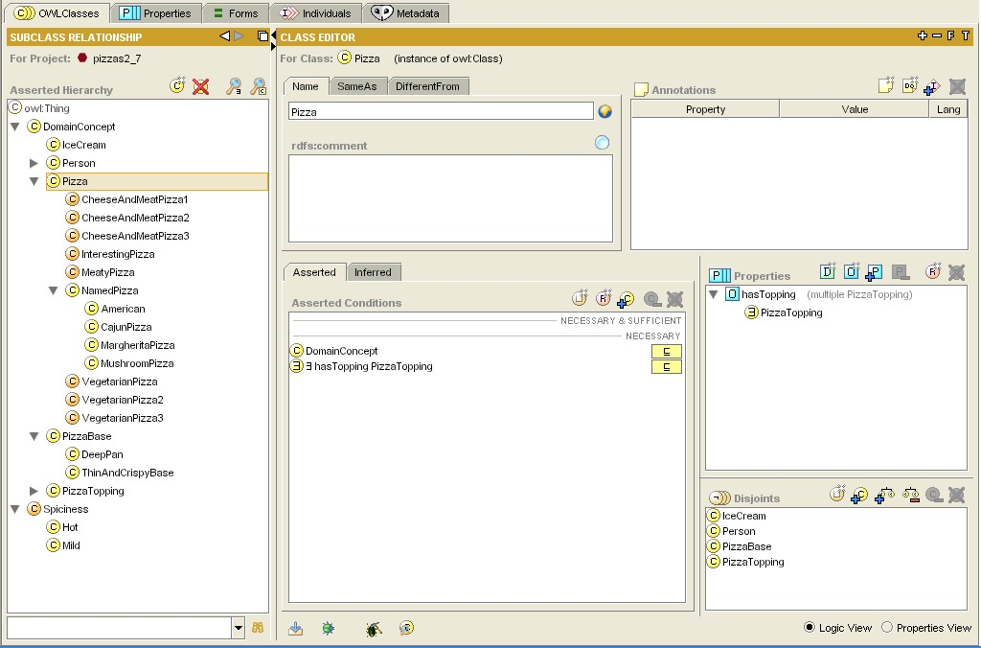
Classes Tab

Slide 11
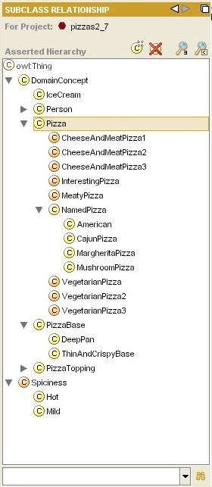
ClassesTab: Asserted Class Hierarchy
Subsumption hierarchy (superclass/subclass)
Structure as asserted by the ontology engineer
Create and Delete classes (actually subclasses!!)
Everything is a subclass of owl:Thing
Search for class

Slide 12
ClassesTab: Class Editor

Slide 13
ClassesTab: Class Editor
Class annotations (for class metadata)
Class name and documentation
Properties “available” to Class
Disjoints widget
Conditions Widget
Class-specific tools (find usage etc)

Slide 14
Create Classes
Start with your empty ontology
Click the “Create Class” button
(this is above the class hierarchy)
A new class will be created as a subclass of owl:Thing
Type in a new name “DomainConcept” over the default
(return updates the hierarchy)
Req. for later labs: document your class using the rdfs:comment field
Create another class called “Pizza” using the same method
You will notice that Pizza has been created as a subclass of DomainConcept as this was the class selected when the button was pressed. You can also right-click any class and select “Create Class”
Create two more subclasses of DomainConcept called “PizzaTopping” and “PizzaBase”.
Any mistakes, use the “Delete Class” button next to “Create Class”

Slide 15
Disjointness
OWL assumes that classes overlap
Pizza
PizzaTopping
= individual
This means an individual could be both a Pizza and a PizzaTopping at the same time
We want to state this is not the case

Slide 16
Disjointness
If we state that classes are disjoint
Pizza
PizzaTopping
= individual
This means an individual cannot be both a Pizza and a PizzaTopping at the same time
We must do this explicitly in the interface

Slide 17
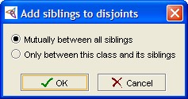
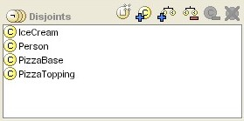
ClassesTab: Disjoints Widget
Add siblings as disjoint
Add new disjoint Remove disjoint siblings
List of disjoint classes

Slide 18
Make Classes Disjoint
Start with your existing ontology
Select the Pizza class
You will notice that the disjoints widget is empty
Click the “Add all siblings…” button
The “Add siblings to disjoints dialog pops up
Select the “Mutually between all siblings” option and OK
PizzaTopping and PizzaBase appear in the disjoints widget
Select the PizzaTopping class
Pizza and PizzaBase are already in the disjoints widget
Note that the same applies for PizzaBase

Slide 19
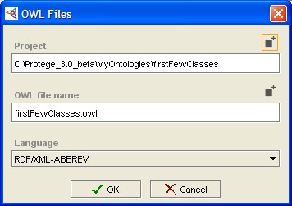
Save Your Work
OWL = easy to make mistakes – save regularly
Select File → Save
A dialog (as shown) will pop up
Select a file using a file selector by clicking the button on the top right
You will notice that there are 2 files created
.pprj – the project file
this just stores information about the GUI
and the workspace
.owl – the OWL file
this is where your ontology is stored in
RDF/OWL format
Select OK

Slide 20
Create PizzaToppings
Start with your existing ontology
Create subclasses of PizzaTopping:
CheeseTopping
VegetableTopping
MeatTopping
Make these subclasses all disjoint from one another
(remember to chose “Mutually between all siblings” when prompted)
Create subclasses of CheeseTopping:
MozzarellaTopping, ParmesanTopping
Make these subclasses all disjoint from one another
Create subclasses of VegetableTopping and make them disjoint:
TomatoTopping, MushroomTopping
Save to another file using File → Save As…

Slide 21
What have we got?
We’ve created a tree of disjoint classes
Disjoints are inherited down the tree
eg something that is a TomatoTopping cannot be a Pizza because its superclass, PizzaTopping, is disjoint from Pizza
You should now be able to select every class (except DomainConcept) and see its siblings in the disjoints widget

Slide 22
What are we missing?
This is not a semantically rich model
Apart from “is kind of” and “is not kind of”, we currently don’t have any other information of interest
We want to say more about Pizza individuals, such as their relationship with other individuals
We can do this with properties
Pizza
PizzaTopping
= individual

Slide 23
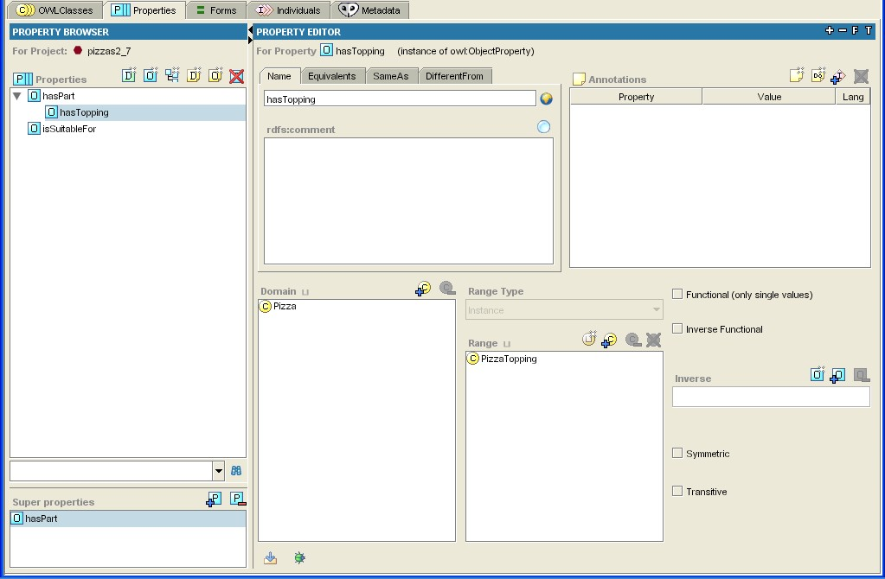
Properties Tab

Slide 24
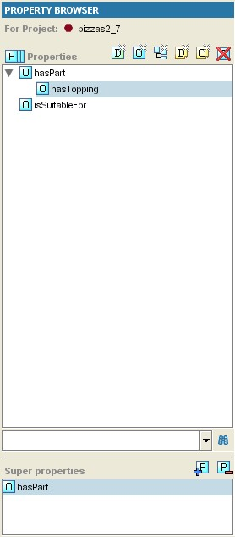
Properties Tab: Property Browser
Properties can be in a hierarchy
Search for property
SuperProperties of the current selected

Slide 25
Properties Tab: Property Browser
Delete Property
New Object Property:
Associates an individual to another individual
not used today:
- New Datatype Property (String, int etc)
- New Annotation Properties for metadata
- New SubProperty – ie create “under” the current selection

Slide 26
Create a Property
Start with your existing ontology
Switch to the Properties tab
There are currently no properties, so the list is blank
Create a new Object property using the button in the property browser
Call the new Property “hasTopping”
Create another Object Property called “hasBase”
Save under a new filename

Slide 27
Associating Properties with Classes
We now have two properties we want to use to describe Pizza individuals.
To do this, we must go back to the Pizza class and add some further information
This comes in the form of Restrictions (which are a type of Condition)

Slide 28
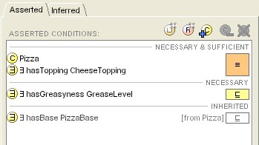
ClassesTab: Conditions Widget
Conditions asserted by the ontology engineer
Add different types of condition
Definition of the class (later)
Description of the class
Conditions inherited from superclasses

Slide 29
Create a Restriction
Start with your existing ontology
Switch to the OWL Classes tab
Select Pizza
Notice that the conditions widget only contains one item, DomainConcept with a Class icon.
Superclasses show up in the conditions widget in this way
Click the “Create Restriction” button
A dialog pops up that we will investigate in a minute
Select “hasBase” from the Restricted Property pane
Leave the Restriction type as “someValuesFrom”
Type “PizzaBase” in the Filler expression editor
Click OK
A restriction has been added to the Conditions widget

Slide 30
What does this mean?
We have created a restriction: ∃ hasBase PizzaBase
on Class Pizza as a necessary condition
hasBase
Pizza
PizzaBase
hasBase
hasBase
hasBase
“If an individual is a member of this class, it is necessary that it has at least one hasBase relationship with an individual from the class PizzaBase”
“Every individual of the Pizza class must have at least one base from the class PizzaBase”

Slide 31
What does this mean?
We have created a restriction: ∃ hasBase PizzaBase
on Class Pizza as a necessary condition
hasBase
Pizza
PizzaBase
hasBase
hasBase
hasBase
“There can be no individual, that is a member of this class, that does not have at least one hasBase relationship with an individual from the class PizzaBase”

Slide 32
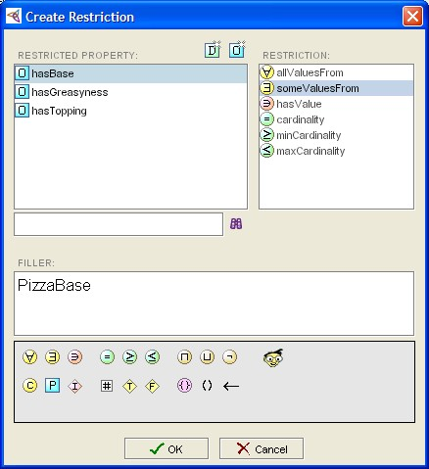
Restrictions Popup
Restricted Property
Restriction Type
Filler Expression
Expression
Construct
Palette
Syntax check

Slide 33
Restriction Types
∃ | Existential, someValuesFrom | “Some”, “At least one”
∀ | Universal, allValuesFrom | “Only”
∋ | hasValue | “equals x”
= | Cardinality | “Exactly n”
≤ | Max Cardinality | “At most n”
≥ | Min Cardinality | “At least n”

Slide 34


Another Existential Restriction
Start with your existing ontology
Make sure Pizza is selected
Create a new Existential (SomeValuesFrom) Restriction with the hasTopping property and a filler of PizzaTopping
When entering the filler, you have 2 shortcut methods rather than typing the entire classname:
1) enter a partial name and use Tab to
autocomplete
2) use the select Class button
on the editor palette

Slide 35
Create a Universal Restriction
Start with your existing ontology
Create 2 disjoint subclasses of PizzaBase
called “ThinAndCrispy” and “DeepPan”
Create a subclass of Pizza called “RealItalianPizza”
Create a new Universal (AllValuesFrom) Restriction on RealItalianPizza with the hasBase property and a filler of ThinAndCrispy

Slide 36
What does this mean?
We have created a restriction: ∀ hasBase ThinAndCrispy
on Class RealItalianPizza as a necessary condition
RealItalianPizza
hasBase
ThinAndCrispy
hasBase
hasBase
hasBase
“If an individual is a member of this class, it is necessary that it must only have a hasBase relationship with an individual from the class ThinAndCrispy”

Slide 37
What does this mean?
We have created a restriction: ∀ hasBase ThinAndCrispy
on Class RealItalianPizza as a necessary condition
DeepPan
RealItalianPizza
hasBase
ThinAndCrispy
hasBase
hasBase
hasBase
hasBase
“No individual of the RealItalianPizza class can have a base from a class other than ThinAndCrispy”

Slide 38
Universal Warning – Trivial Satisfaction
If we had not already inherited: ∃ hasBase PizzaBase
from Class Pizza the following could hold
RealItalianPizza
hasBase
ThinAndCrispy
hasBase
Trivially satisfied
by this individual
hasBase
hasBase
“If an individual is a member of this class, it is necessary that it must only have a hasBase relationship with an individual from the class ThinAndCrispy, or no hasBase relationship at all”
ie Universal Restrictions by themselves do not state “at least one”

Slide 39
Summary
You should now be able to:
identify components of the Protégé-OWL Interface
create Primitive Classes
create Properties
create some basic Restrictions on a Class using Existential and Universal qualifiers

Slide 40
More exercises:
Create a MargheritaPizza
Start with your existing ontology
Create a subclass of Pizza called NamedPizza
Create a subclass of NamedPizza called MargheritaPizza
Create a restriction to say that:
“Every MargheritaPizza must have at least one topping from TomatoTopping”
Create another restriction to say that:
“Every MargheritaPizza must have at least one topping from MozzarellaTopping”

Slide 41
More exercises:
Create other pizzas
Start with your existing ontology
Add more topping ingredients as subclasses of PizzaTopping
Use the hierarchy, but be aware of disjoints
Create more subclasses of NamedPizza
Menus available at the front
Create a restrictions on these pizzas to describe their ingredients
Save this for the next session

